Slide 1
Good morning year 6 I hope you are well. Remember I am here to help if you have any questions about the work I have set.
Thursday 14th January 2021

Slide 2
Good morning! To wake up your brain, have a go at the following task:
Try to get as close as you can to the target number using these six numbers:
50 9 10 6 4 3
Target Number: 948
You can't use the same number more than once.
Only add, subtract, multiply and divide are allowed.

Slide 3
Arithmetic

Slide 4
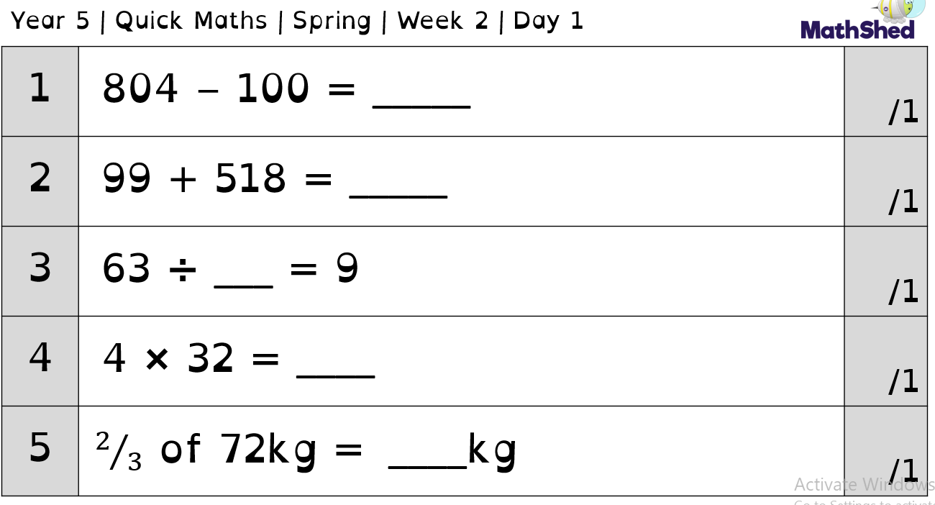
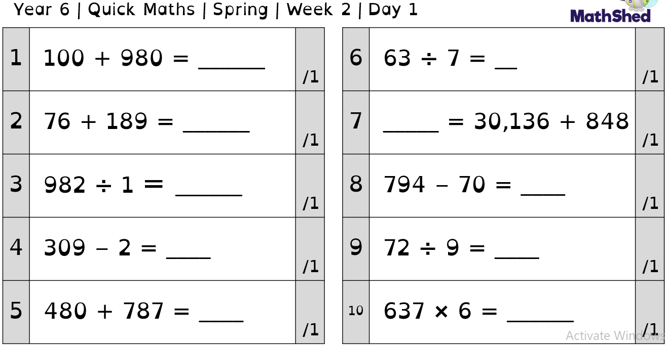

Slide 5
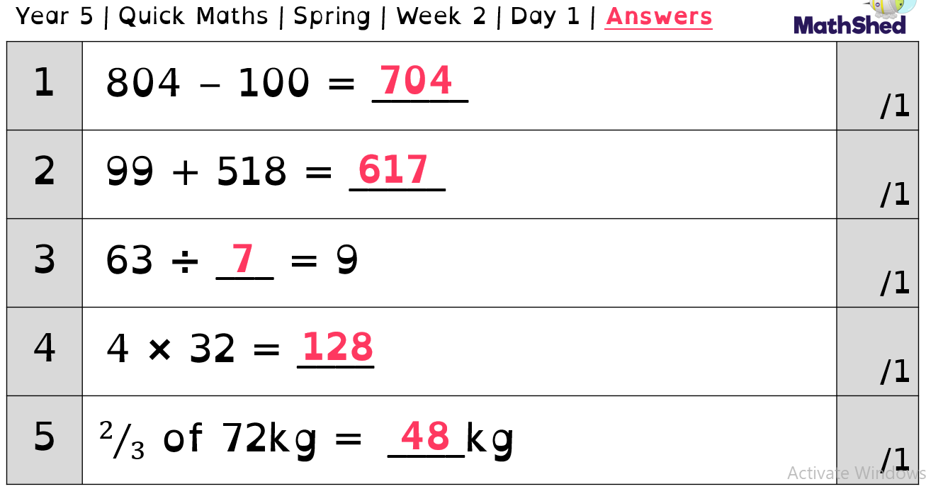
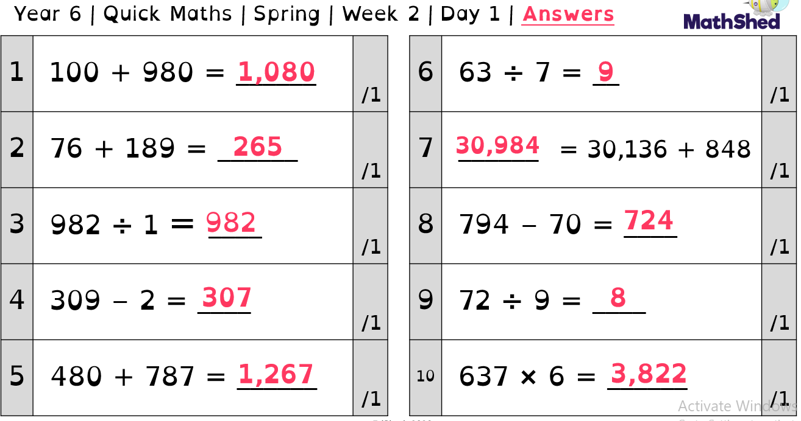

Slide 6
PSHE

Slide 7
At this time it is important to think about our mental health.
Today we are going to focus on things that can help us to stay happy and safe whilst we are having to spend more time at home.
Our first activity is to think about the things we are not going to be able to do at the moment due to the new lockdown.
Create a list of activities that you are not going to be able to do at the moment.

Slide 8
Alternatives
It’s important to try and think of alternatives to help us stay happy at home, for example instead of going to our friends house we can have a zoom/facetime with them.
Look at your list of things that we can’t do at the moment, think of an alternative to each one. That will be fun whilst keeping us safe.
Can you think of more than one alternative for them.

Slide 9
Once you have made you list of alternatives, have a look at the activity below.
I want you to create a poster all about the alternatives that we could use. This will help us to remember that although we are not able to do everything we can still enjoy ourselves using these.

Slide 10
English
Synonyms

Slide 11
Today we are going to introduce some vocabulary surrounding big cats and how they eat (to help us write our own non-chronological report). We will improve words using synonyms.
Watch the following video for support.
https://classroom.thenational.academy/lessons/to-develop-a-rich-understanding-of-words-associated-with-eating-6mtkec?activity=video&step=1
Now, make a list of verbs you could use to describe how a big cat eats. What could you use to help you? Can you put these into sentences to show your understanding?

Slide 12
Guided reading

Slide 13
Guided reading
We are again going to be continuing with the text ‘We see everything’. Today we are going to be using our inference skills to decide what is going to happen next.
Quickly recap the story so far. Write a short review of this. Include things like what we know has happened, who we think the main character is and whether you have enjoyed what we have read.

Slide 14
Prediction time
Like a great clairvoyant we are now going to predict the future.
I want you to write or create a comic strip of what is going to happen next. Think carefully about what has happened and what realistically could happen next.

Slide 15
Spelling

Slide 16
So far we have looked at -cian and -tion. What other spellings did we have?

Slide 17
Which is the most common spelling?

Slide 18
Which is the most common spelling?
Tion!

Slide 19
Can you think of any exceptions to the spellings we have found?
What other endings that use the ‘shun’ sound did you find?

Slide 20
RE

Slide 21
What is a ‘foundation for living’?

Slide 22
Foundations for living are the ideas and beliefs which people think are important for life.
e.g.
Trusting god
Money
Fashion
Being kind

Slide 23
What do you think makes for strong foundations in life? Write a short paragraph to show this.

Slide 24
What do Christians do to build good foundations? Make a list of what a Christian would do to do this.E.g. they go to church, they give to charity

Slide 25
How are these similar/different to Christian foundations?

Slide 26
Foundations for living
Complete the Venn diagram, writing some of the foundations for living into the correct section (there are some example ideas on the page after). Some of them may not be a foundation for living and you will need to make that judgement.
Copy and complete the sentences:
- The Christian community ...... to help people secure good foundations for life.
- Other people get foundations for life from....
C: These are the same/different to Christian foundations because they....

Slide 27
Foundations for anyone
Foundations for Christian living

Slide 28
